Slide 1
The map is relatively simple, and there are only 2 pathways to the ocean: 19→20→6→10, and 18→2→10
We can calculate the flows by multiplying the inputs (18 & 19) by the proportions of the flows. We can then look at the effect on ocean leakage of increasing any of the flows in the pathways by 1 Mt, and this provides a measure of sensitivity.

Slide 2
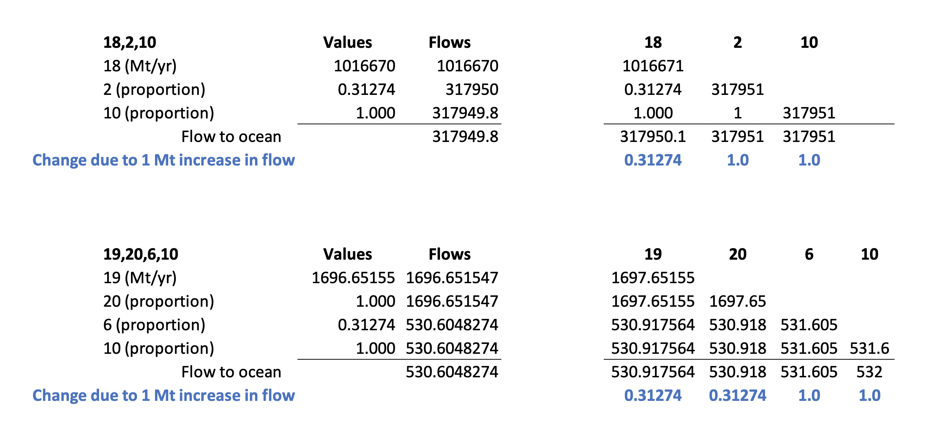
These are the values for UMI-X-Urban:
(here each flow is increased by +1)
(this is how much the ocean leakage increases by)

Slide 3
*
*
*
*
*
*
* A 1 Mt increase in these flows increases ocean leakage by 1 Mt : sensitivity = 1
* A 1 Mt increase in these flows increases ocean leakage by 0.313 Mt : sensitivity = 0.313

Slide 4
Doing this for all of the archetype/scenarios, i.e. the sensitivity of ocean leakage to each of the contributing flows:

